Slide 1
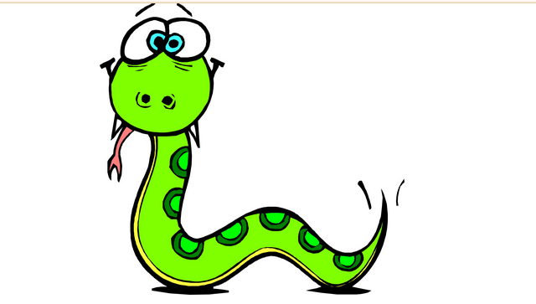
Presentation on
2D Game using java
(AWT & SWING)
Name🡪Manoti Mehrotra
Section->D
Roll No.->
63
(1918456)

Slide 2
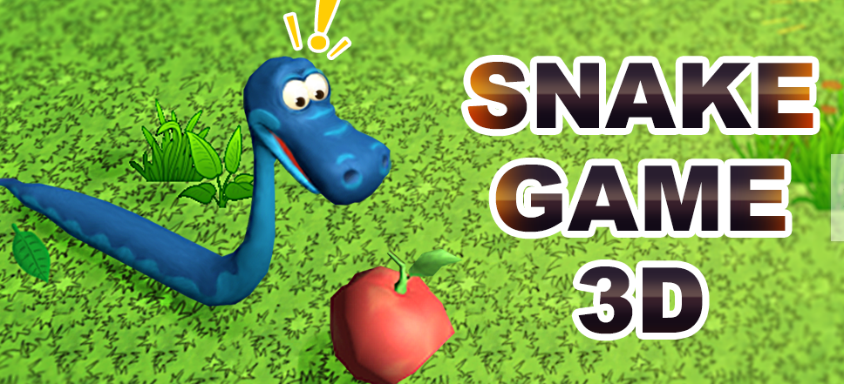
Snake Game
Snake is an older classic video game. It was first created in late 70s. Later it was brought to PCs. In this game the player controls a snake.
The objective is to eat as many apples as possible. Each time the snake eats an apple its body grows. The snake must avoid the walls and its own body. This game is sometimes called Nibbles.
In this game, the head of the snake is represented by red dot and other part of the body shown by green dot.
2D
Notes:
2

Slide 3
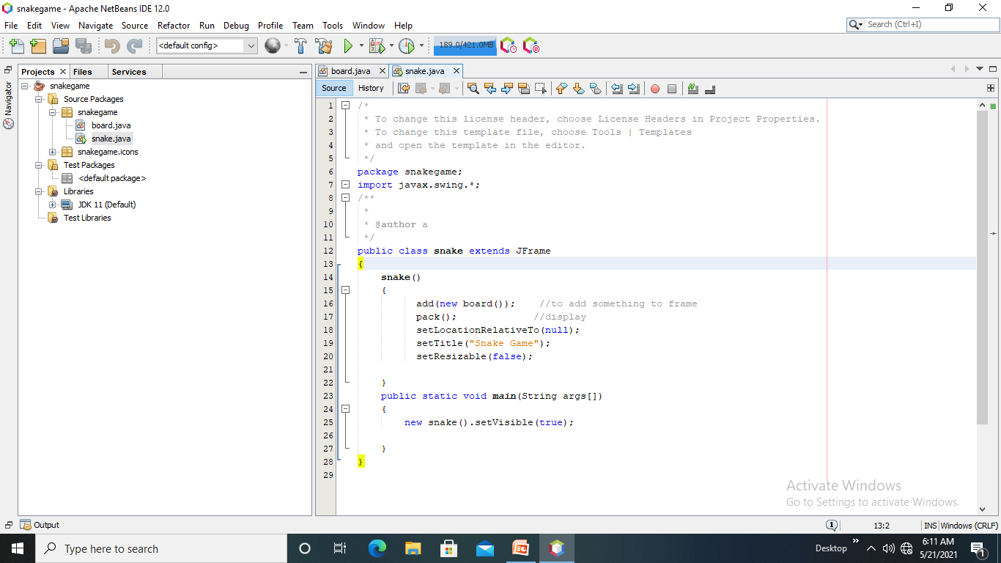
Basics
Here I made 2 classes
1. snake class
2. board class
Snake class- extends Jrame to create frame for the game.
To add something on a frame we use add() method then ,pack() method is use
to display the frame .
Setlocation method tells to set location here set to null
Using visible the frame on which snake runs get visible.

Slide 4
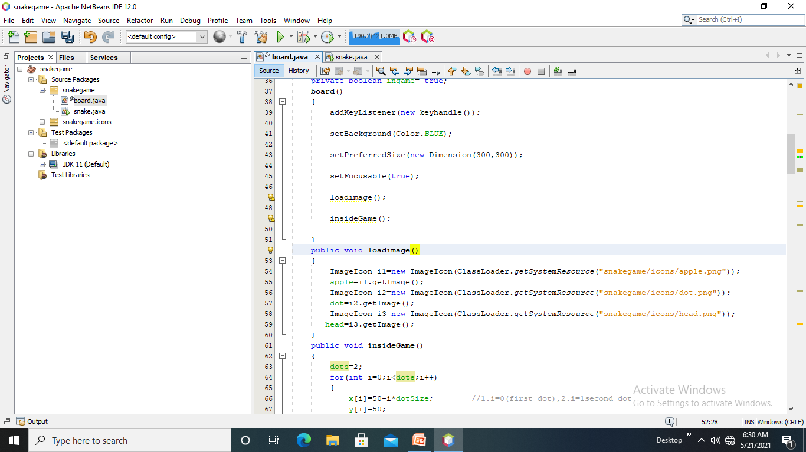
In this board class ,action listener is added to provide movement to the snake through keys. Set focus () – for setting ocus to frame and on snake ,apple. Now creating 2 methods –loadimage ()- apple,head,body.and insidegame()-for setting x and y axis on which snake moves.

Slide 5
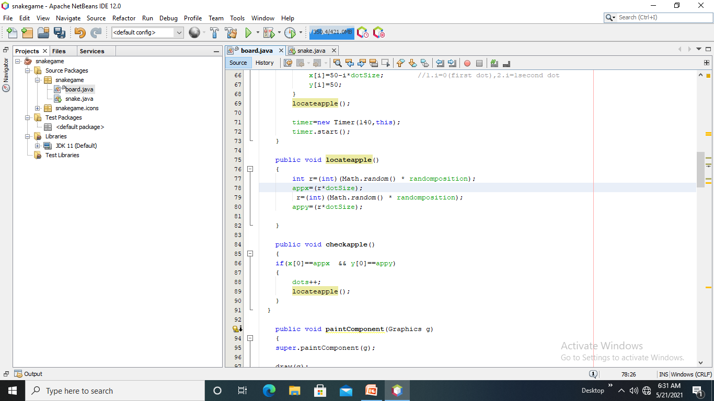
locateapple() function is created to set the apple at random position ,checkapple()- to check if snake head [0][0] and apple coordinates are same then snake eats up an apple dots are incremented,then again apple is required to eat so locateapple() is called. Paintcomponent() –draw graphic objects as parameters.
private final int dotSize =10;
private final int alldots=900;
m

Slide 6
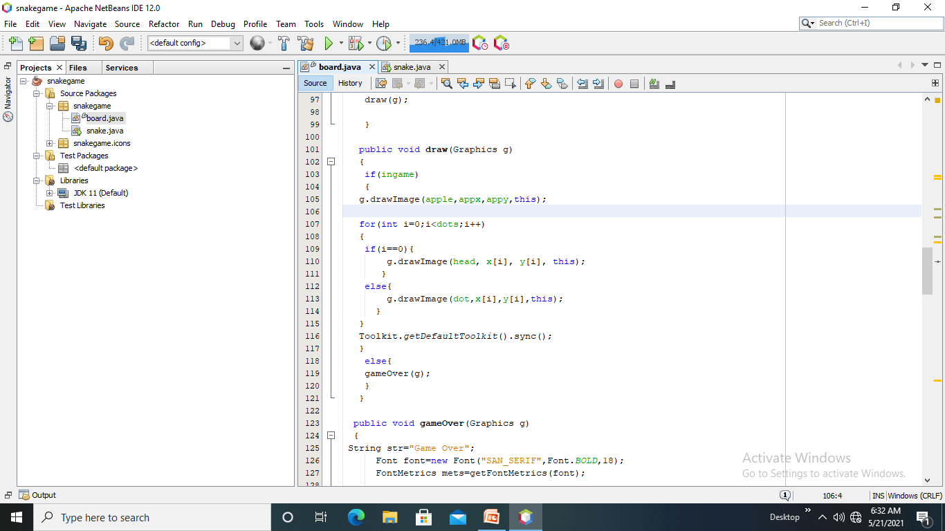
Draw()-to draw apple,head,dot if inside the game. If i=0 then draw a dot on frame as head, if not then put a the dot on frame .
Toolkit method helps to set font and color
Otherwise quit the game. Gameover()- sets all things for frame and quits.

Slide 7
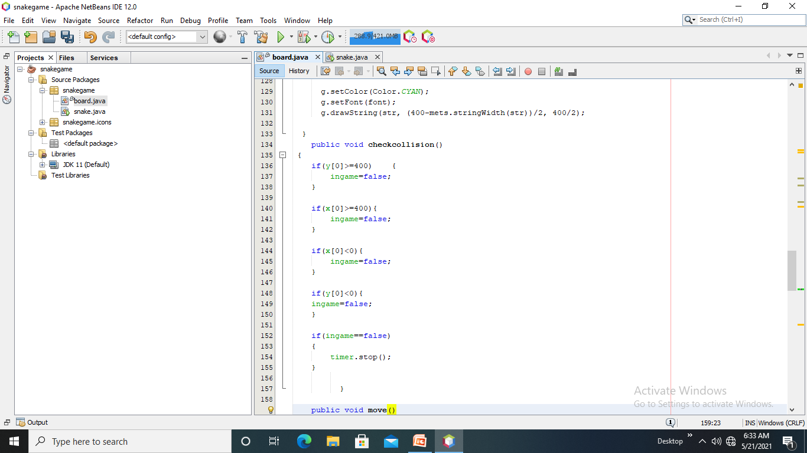
Checkcollision()= it is a condition for losing a game, and thr timer stops after lose.
As the snake head touches the boundary last coordinate then game .

Slide 8
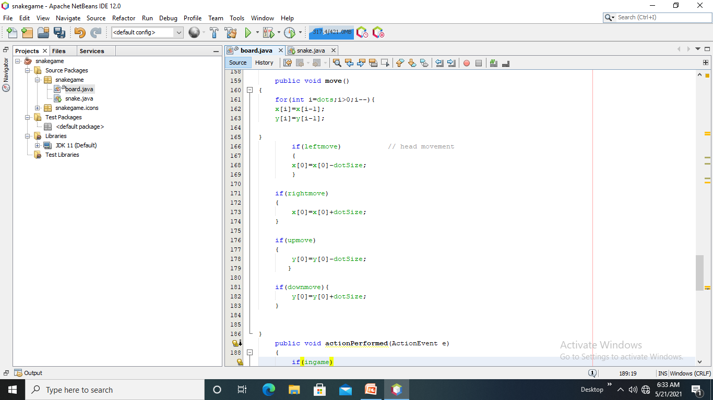
Move() is used to move the dot on the frame.

Slide 9
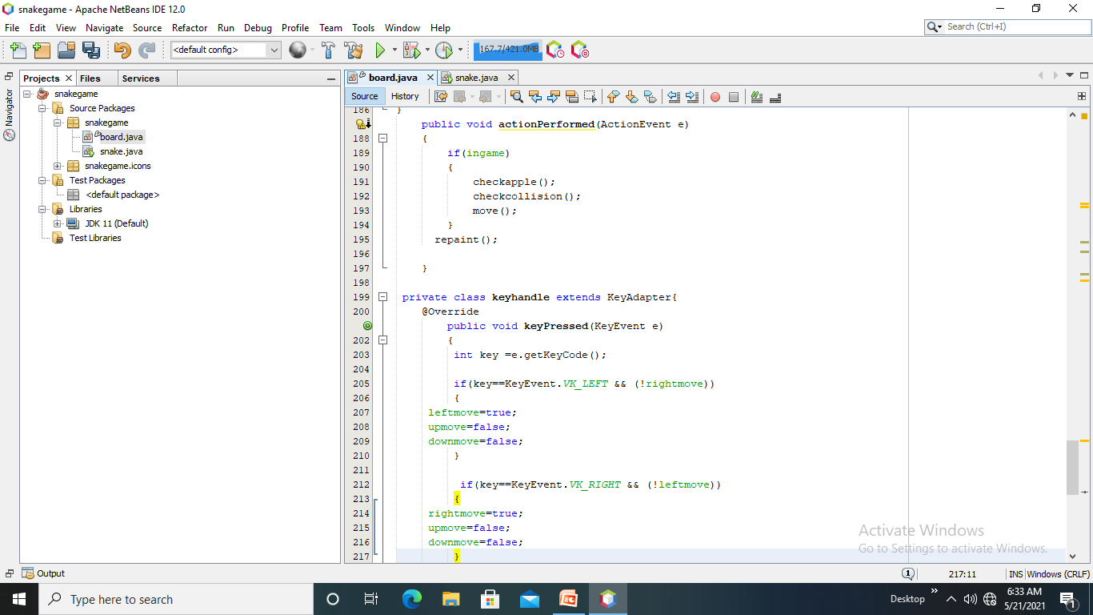
Actionlistener class handles all action events ,all keys for moving snake .
repaint() is used to update the frame and then this further code shows the right ,left; up and down movement of the snake according to the key pressed.

Slide 10
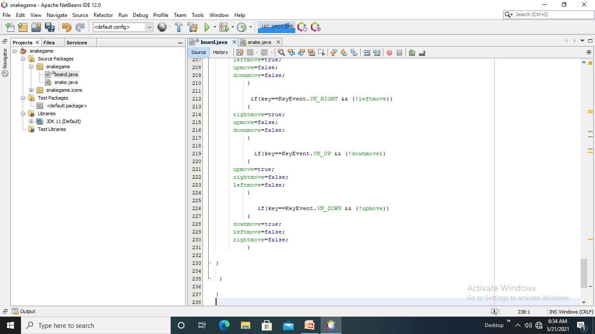
As we see in action listener-the logic of the movement is clear- the snake moves left it cant turn to right directly ,it has to go up/down to turn right .Similarly for the up and down.

